Slide 1

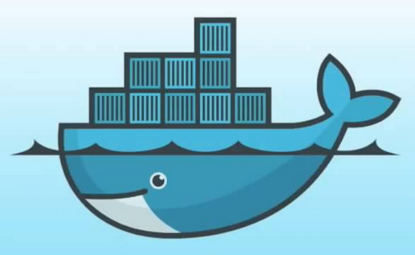
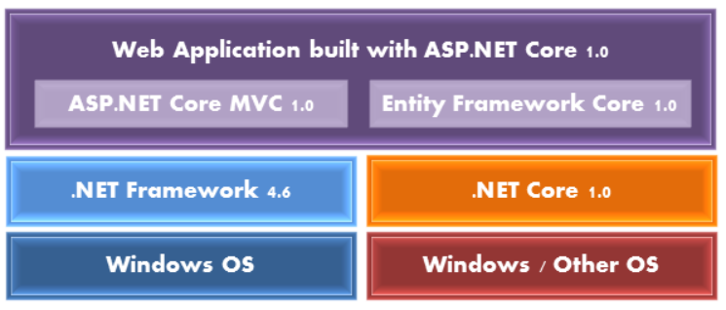
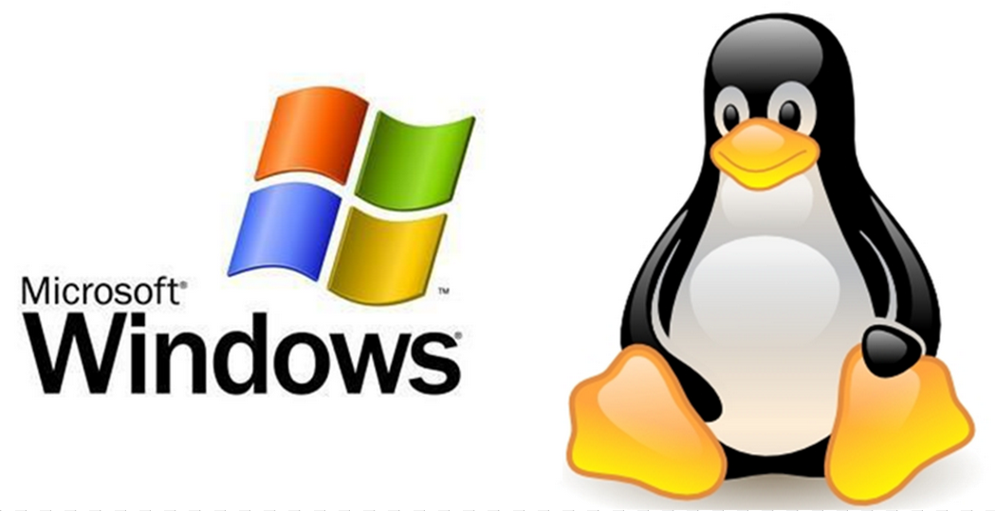
.NET Core and ASP.NET Core App On Windows、Linux with Docker
Shawn 201610

Slide 2
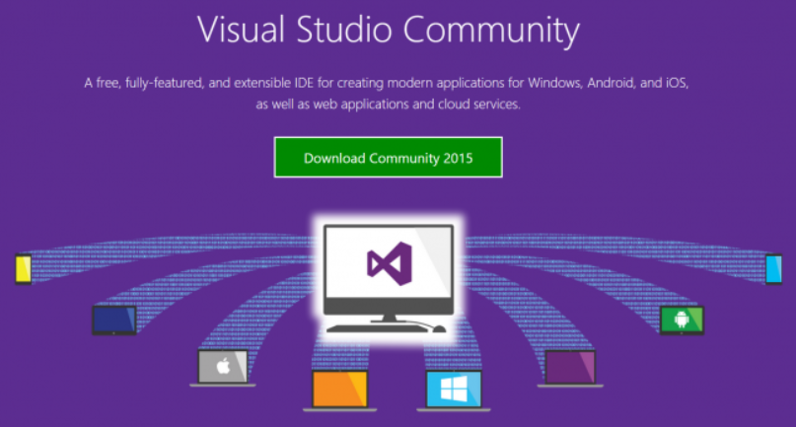
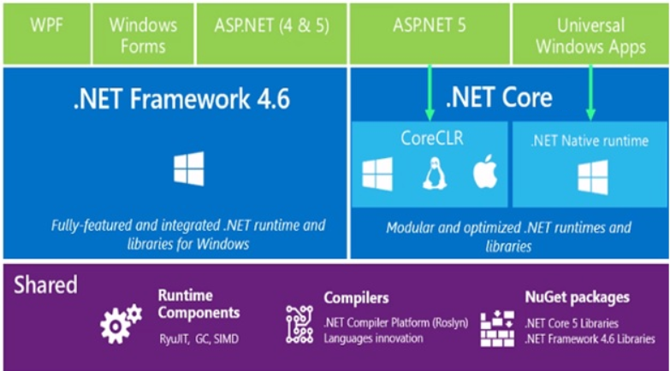
大綱
Visual Studio
Visual Studio 2015 (Professional 、 Enterprise)
Visual Studio Community
Visual Studio Code
.NET Core and ASP.NET Core (ASP.NET 5)
Docker for Windows and MAC
Run Docker for Windows
Run .NET Core and ASP.NET Core
On Windows
On Windows with Docker
On Linux (CentOS)
On Linux (CentOS) with Docker
On Linux (Ubuntu)
On Linux (Ubuntu) with Docker
Dev .NET Core and ASP.NET Core with Docker
About refactor current job program

Slide 3
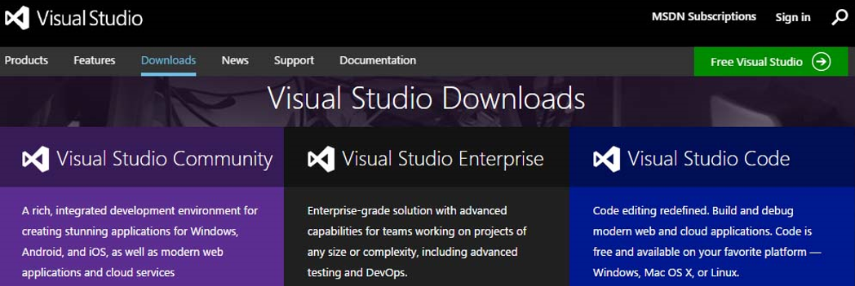
Visual Studio
Visual Studio 2015 (Professional 、 Enterprise)
Windows 平台，適用於個人開發人員及小型小組的專業開發人員工具及服務
可開發用於 iOS、 Android 和 Windows 的裝置應用程式、Web 應用程式和雲端應用程式
Visual Studio Community (Free)
Windows 平台，可供開發人員建置非企業應用程式的免費、功能完整且可擴充的工具
開發功能近似 Visual Studio 2015，去除 TFS 功能，有非企業等授權限制
Visual Studio Code (Free)
Windows、Linux、Mac 平台，免費的開源文字編輯器
支援偵錯功能，內建了Git 版本控制功能，同時也具有開發環境功能，例如代碼補全（類似於 IntelliSense）、代碼片段等功能

Slide 4
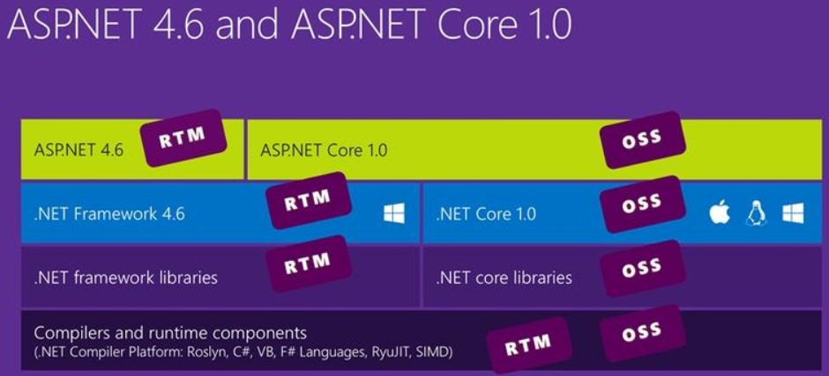
.NET Core and ASP.NET Core
.NET Core (Mac/Linux/Windows)
Home repository for .NET Core
https://github.com/dotnet/core
.NET Core 是 .NET Framework 的新一代版本，具有跨平台 (Windows、Mac OSX、Linux) 能力的應用程式開發框架， 包含大部分 .NET Framework 的類別庫，基於跨平台能力.NET Core ，並沒有將與 GUI 高度相關的 API 移植到 .NET Core 內，因此像是 Windows Form 或是 Windows Presentation Foundation (WPF) 並未移植到 .NET Core，.NET Core 支援主控台應用程式 (Console Application) 、類別庫 (Class Library) 類型及Web 應用程式 (ASP.NET Core Web Application) 的專案
與 .NET Framework 不同的是 .NET Core 採用套件化 (Packages) 的管理方式，應用程式只需取得需要的組件即可，與 .NET Framework 大包式安裝的作法截然不同，同時各套件亦有獨立的版本線，不再硬性要求應用程式跟隨主線版本
.NET Core development on Windows with Visual Studio requires:
A supported version of the Windows client or operating system.
Visual Studio 2015 Update 3.3 or later
NuGet Manager extension for Visual Studio
.NET Core Tooling Preview 2

Slide 5
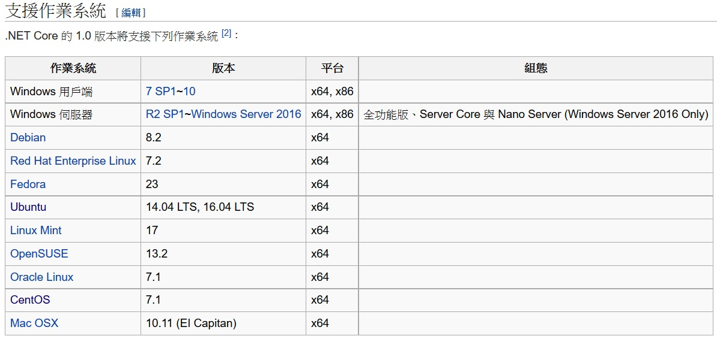
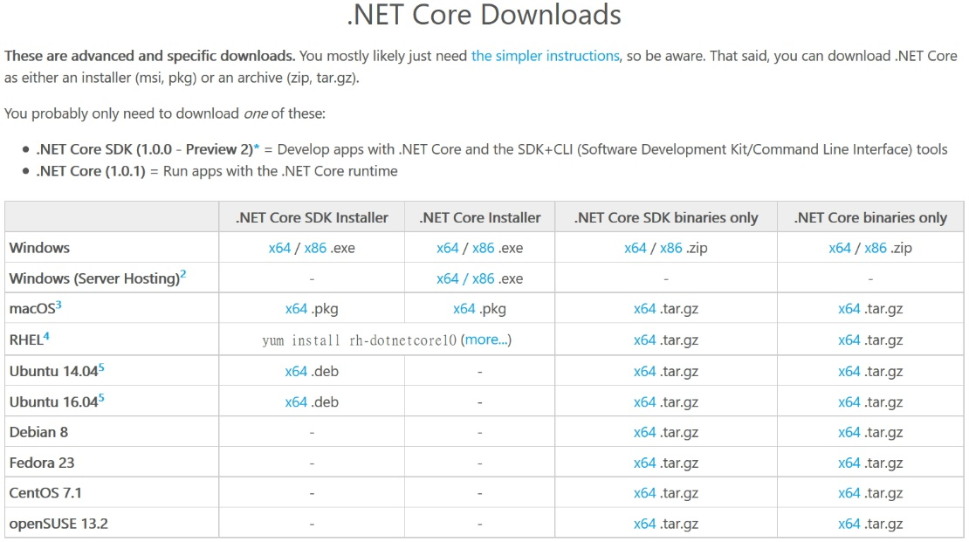
.NET Core and ASP.NET Core
https://www.microsoft.com/net/download

Slide 6
.NET Core and ASP.NET Core
ASP.NET Core 可運行於 Windows 平台以及非 Windows 平台，如 Mac OSX 以及 Ubuntu Linux 作業系統，是 Microsoft 第一個具有跨平台能力的 Web 開發框架
Documentation for ASP.NET Core
https://github.com/aspnet/Docs
ASP.NET Core 支援自我代管 (Self-hosting) 以及 Web Server 代管 (Web Server-hosting) 的功能
ASP.NET Core 不再依賴 IIS，執行環境由新開發具跨平台能力的 Kestrel Server 負責，IIS 退回到 HTTP 的聆聽器的角色
ASP.NET Core 以 .NET Core 的基礎發展，其目前規劃的功能有：
ASP.NET Core MVC : 目前欽定的 Web 應用程式開發框架
ASP.NET SignalR 3: 新一代的長時輪詢 (Long-Time Polling) 訊息通訊基礎建設
Entity Framework Core: 下一代的 ADO.NET Entity Framework，採用 .NET Core 並重新設計，為欽定的 ORM 資料存取技術
ASP.NET Core 的可用開發工具則有：
Visual Studio，內建有 ASP.NET Core 的專案範本，也能夠使用 IDE 的功能建造與部署應用程式 (例如 Azure Web App 或是 ASP.NET Docker Image on Azure 等)
Visual Studio Code，跨平台的 Visual Studio 編輯器
Yeoman Generator for ASP.NET，提供給 Mac 與 Linux 等作業系統，可直接產生專案範本的工具
只要是文字編輯器都可以編修 project.json 與程式碼檔案，但要自行處理建造與部署的細節

Slide 7
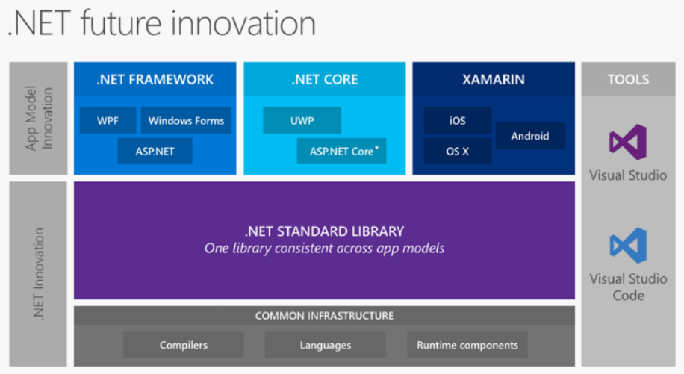
.NET Core and ASP.NET Core

Slide 8
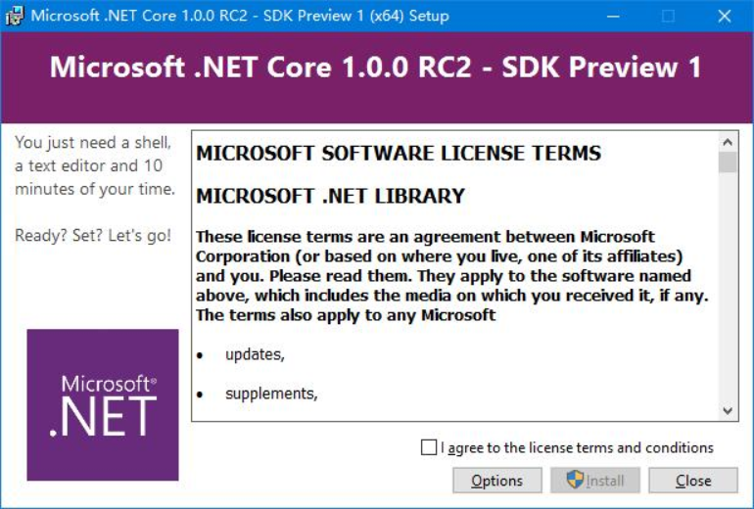
Run .NET Core and ASP.NET Core
On Windows
Install .NET Core SDK (Use Visual Studio)
Visual Studio 2015 Update 3
https://go.microsoft.com/fwlink/?LinkId=691129
.NET Core 1.0.1 - VS 2015 Tooling Preview 2
https://go.microsoft.com/fwlink/?LinkID=827546
也可只安裝 .NET Core SDK for Windows 然後使用任何文字編輯器與 .NET CLI 進行程式開發與編譯
.NET Core SDK for Windows
https://go.microsoft.com/fwlink/?LinkID=827524
Visual Studio Code (free)
https://code.visualstudio.com/

Slide 9
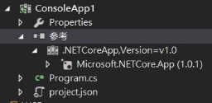
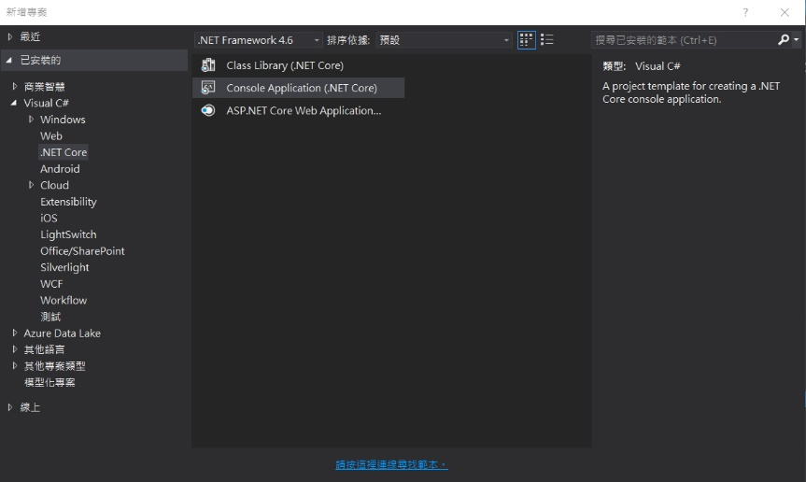
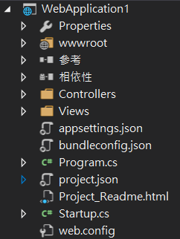
Run .NET Core and ASP.NET Core
On Windows
Use Visual Studio

Slide 10
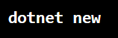
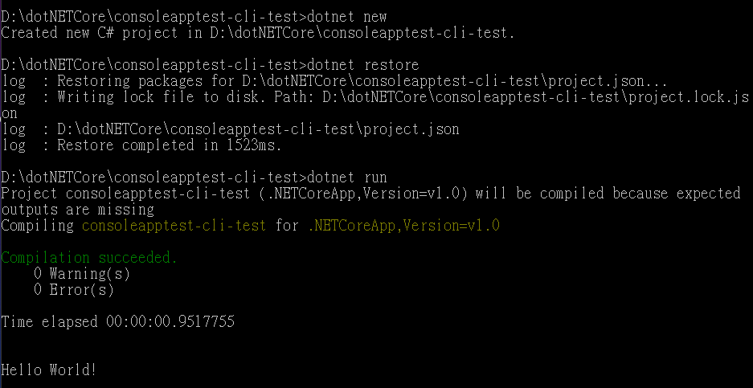
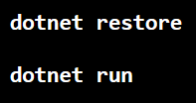
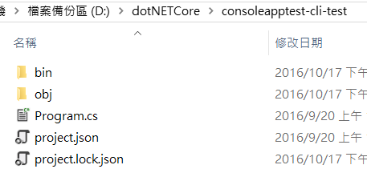
Run .NET Core and ASP.NET Core
.NET Core On Windows
Use .NET CLI (.NET Core cross-platform command-line interface)
Initialize a sample Hello World application
Run the app

Slide 11
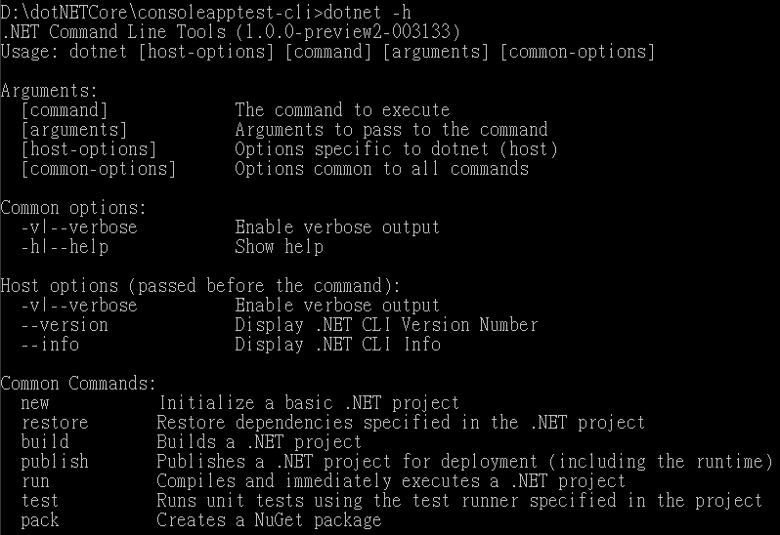
Run .NET Core and ASP.NET Core
.NET CLI

Slide 12
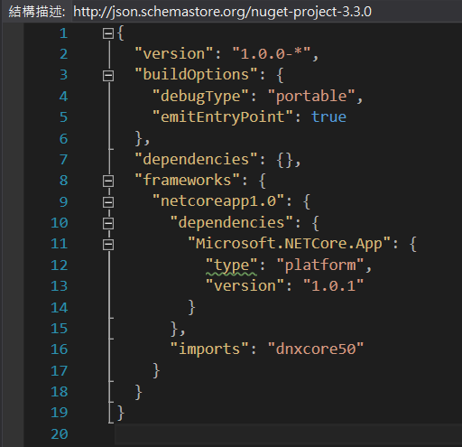
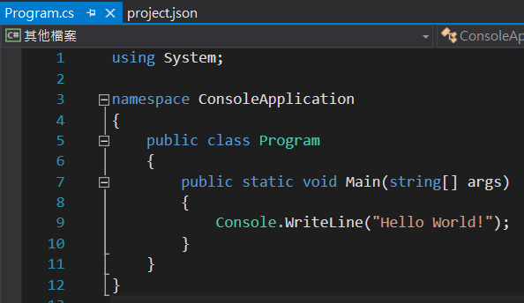
Run .NET Core and ASP.NET Core
.NET Core On Windows
project.json 主掌專案的執行期的組態設定，
包含專案的套件參考 (Package References)、專案的基本設定、
啟動指令、包含或排除指定目錄、以及建造時的相關事件指令等

Slide 13
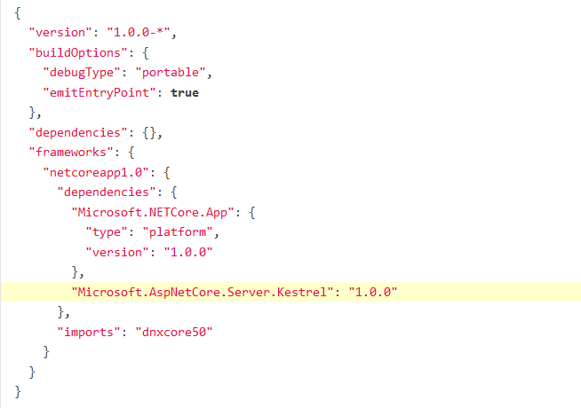
Run .NET Core and ASP.NET Core
ASP.NET Core On Windows
Use .NET CLI
Create a new .NET Core project
Update the project.json file to add the Kestrel HTTP server package as a dependency

Slide 14
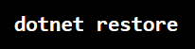
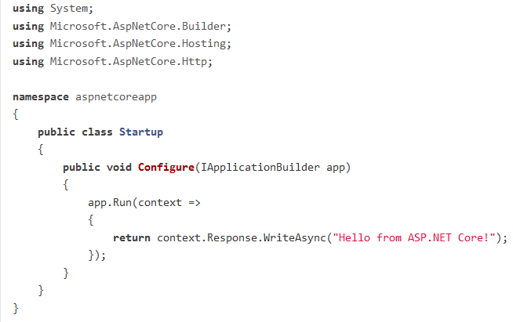
Run .NET Core and ASP.NET Core
ASP.NET Core On Windows
Use .NET CLI
Restore the packages
Add a Startup.cs file that defines the request handling logic

Slide 15
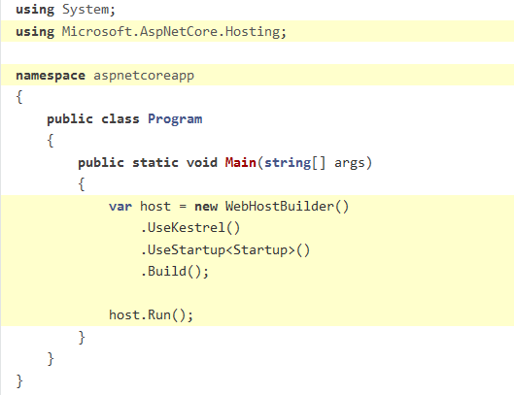
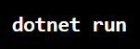
Run .NET Core and ASP.NET Core
ASP.NET Core On Windows
Use .NET CLI
Update the code in Program.cs to setup and start the Web host
Run the app

Slide 16
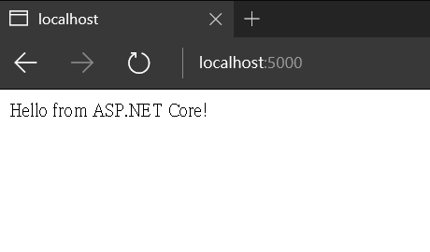
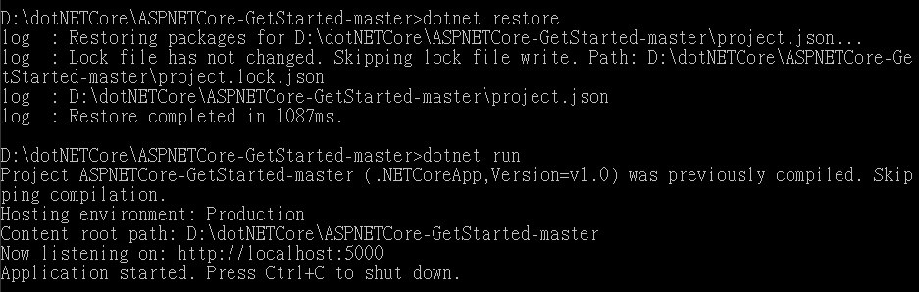
Run .NET Core and ASP.NET Core
ASP.NET Core On Windows
Use .NET CLI
Run the app

Slide 17
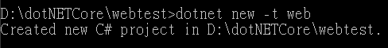
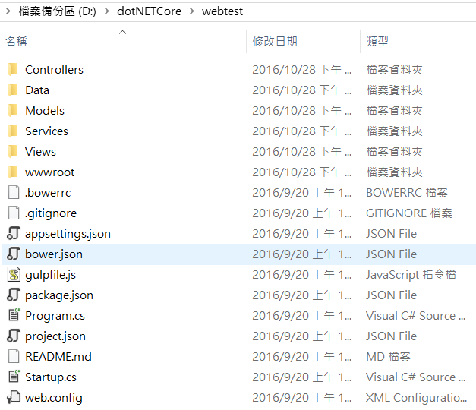
Run .NET Core and ASP.NET Core
ASP.NET Core On Windows
Use .NET CLI
dotnet new -t web
可透過此指令建立完整的 ASP.NET Core Web App 的架構範本

Slide 18
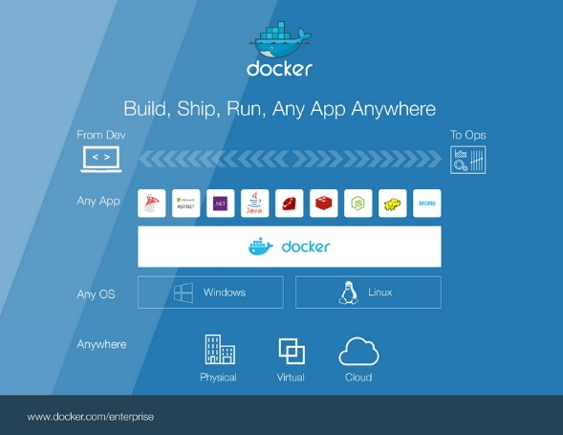
Docker for Windows and MAC
Docker for Windows
Docker 公司正式推出全新的 Docker for Windows 版本，本次推出的版本是個原生 Windows 應用程式
不再需要借助 VirtualBox、Docker Toolbox、boot2docker 或其他工具就可以執行，只要你的 Windows 作業系統是 Windows 10 專業版或企業版 (64-bit)，並在安裝 Hyper-V 功能之後即可進行安裝與設定
提供原生Windows使用者操作介面、及自動更新功能給使用者，而Docker工具組內則包含了Docker命令列、Docker Compose及Docker Notary命令列
You have two options for installing Docker on Windows
Docker for Windows (適用於 Windows 10 以上)
https://docs.docker.com/docker-for-windows/
Docker Toolbox (適用於 Windows 10 以下)
https://docs.docker.com/toolbox/toolbox_install_windows/
Docker for Mac
You have two options for installing Docker on Mac
Docker for Mac
https://docs.docker.com/engine/installation/mac/#docker-for-mac
Docker Toolbox
https://docs.docker.com/engine/installation/mac/#docker-toolbox

Slide 19
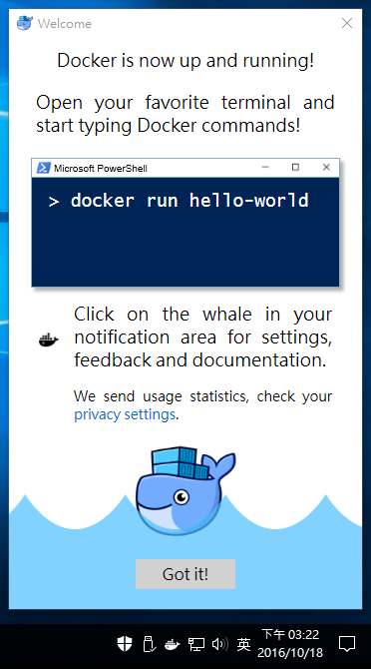
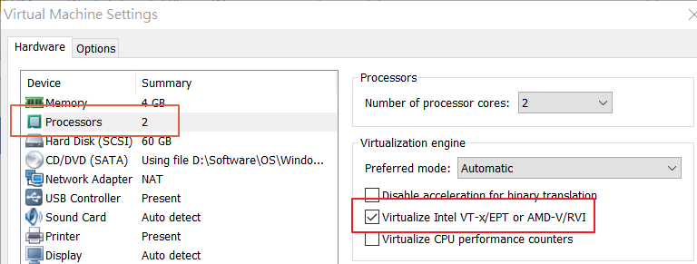
Run Docker for Windows
Download and Install Docker for Windows
https://docs.docker.com/docker-for-windows/
http://blog.miniasp.com/post/2016/08/01/Docker-for-Windows-1-12-Released.aspx
Requires
64bit Windows 10 Pro, Enterprise and Education and Microsoft Hyper-V
(1511 November update, Build 10586 or later)
If Windows run on VMware
4 GB RAM available minimum. Nested virtualization requires a good amount of memory
This feature is currently Intel-only. Intel VT-x is required

Slide 20
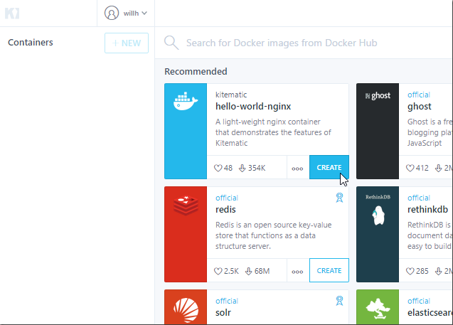
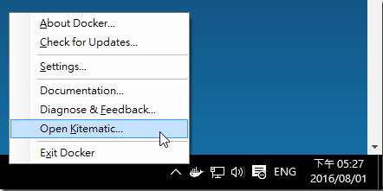
Run Docker for Windows
Kitematic (Docker GUI)

Slide 21
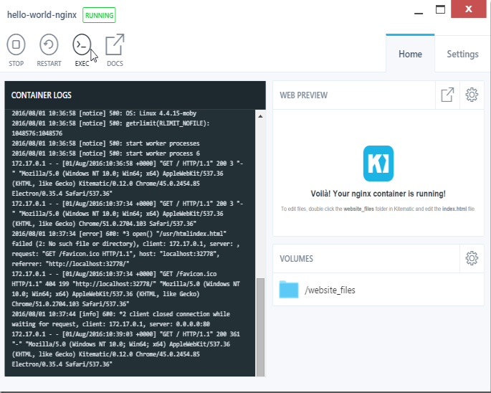
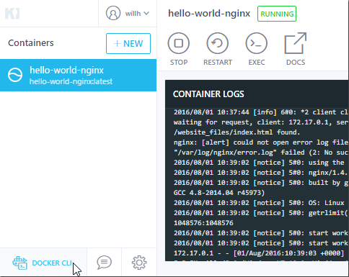
Run Docker for Windows
Kitematic (Docker GUI)

Slide 22
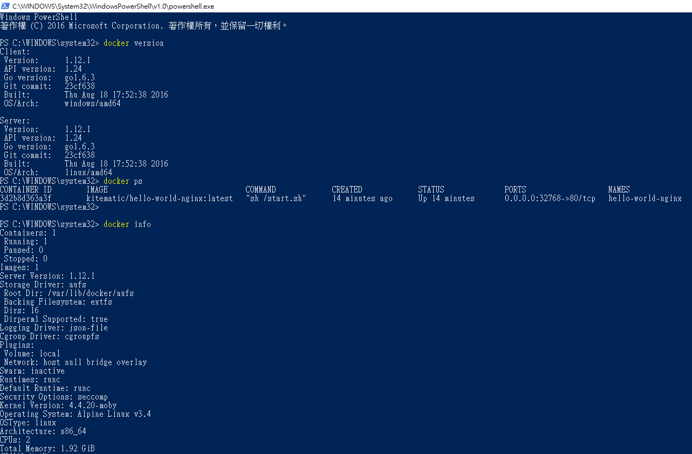
Run Docker for Windows
Start your favorite shell (cmd.exe, PowerShell, or other)
docker version
Show the Docker version information
docker ps
List containers
docker info
Display system-wide information
docker build
Build an image from a Dockerfile
docker pull
Pull an image or a repository from a Docker registry
docker run
Run a command in a new container
The Docker commands
https://docs.docker.com/engine/reference/commandline/

Slide 23
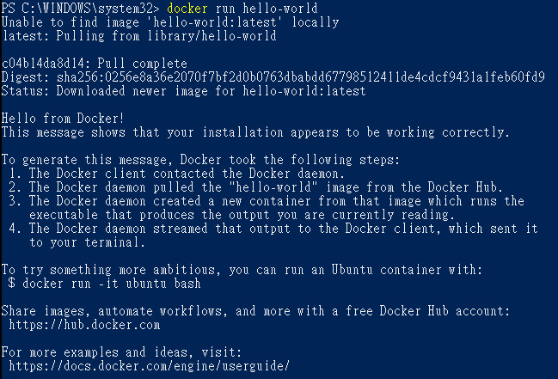
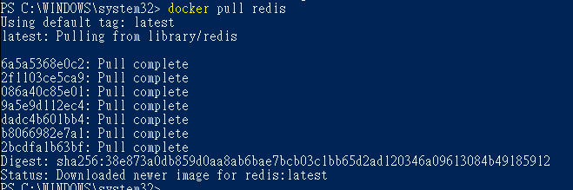
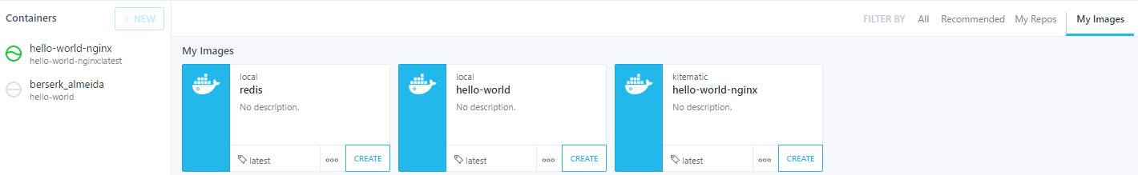
Run Docker for Windows
取得 Docker Image 並建立 Container 執行
docker pull
docker run

Slide 24
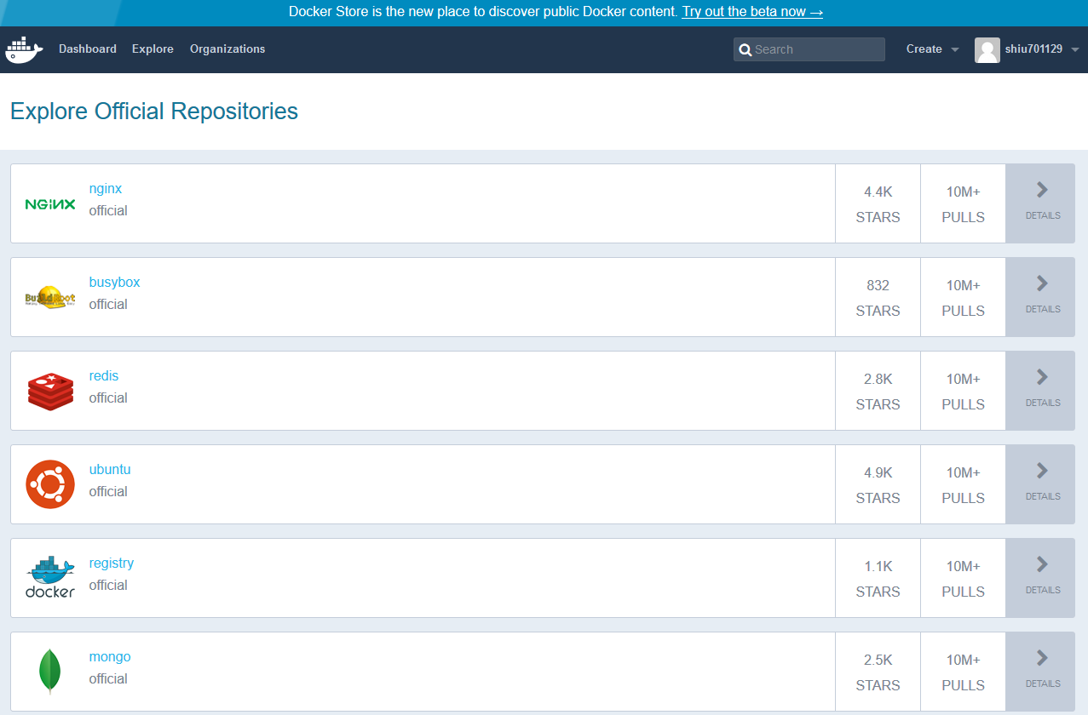
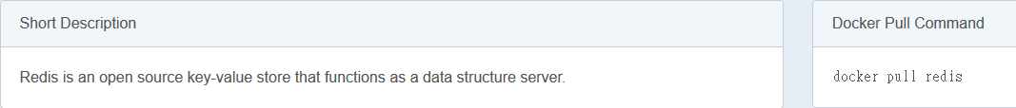
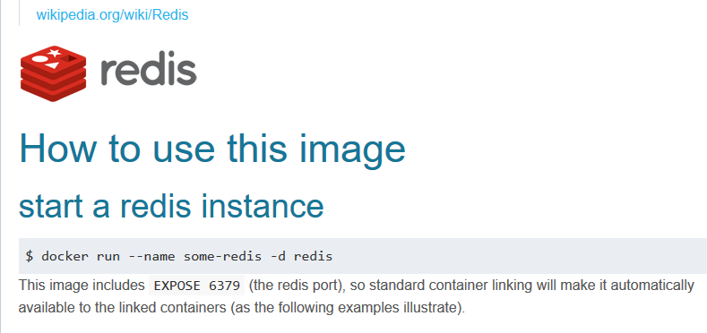
Run Docker for Windows
Docker Hub
https://hub.docker.com/explore/

Slide 25
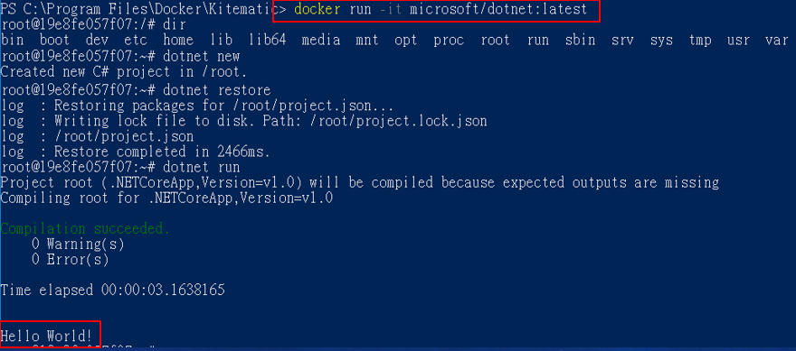
Run .NET Core and ASP.NET Core
On Windows with Docker
取得官方的 .NET Core Image 並建立 Container 執行，確定版本運作正常
docker run –it microsoft/dotnet:latest
dotnet new
dotnet restore
dotnet run

Slide 26
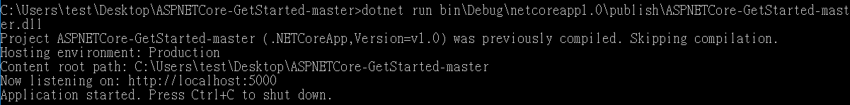
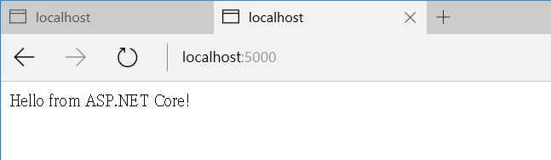
Run .NET Core and ASP.NET Core
On Windows with Docker
將 ASP.NET Core 程式打包
dotnet publish
執行打包後的程式，確定運作正常
dotnet run bin\Debug\netcoreapp1.0\publish\ASPNETCore-GetStarted-master.dll

Slide 27
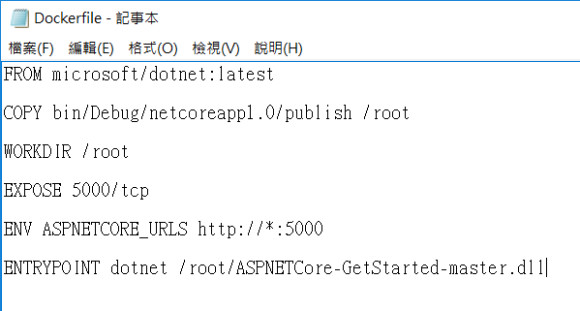
Run .NET Core and ASP.NET Core
On Windows with Docker
在專案目錄中建立 Dockerfile
FROM microsoft/dotnet:latest
COPY bin/Debug/netcoreapp1.0/publish /root
WORKDIR /root
EXPOSE 5000/tcp
ENV ASPNETCORE_URLS http://*:5000
ENTRYPOINT dotnet /root/ASPNETCore-GetStarted-master.dll
FROM tells Docker that you want to base your image on the existing image called
COPY and WORKDIR copy the current directory’s contents into a new directory inside the container called and set that to the the working directory for the subsequent instructions
EXPOSE tells Docker to expose port 5000 (the default port for ASP.NET) on the container
ENV sets the environment variable ASPNETCORE_URLS in the container. This will ensure that ASP.NET Core binds to the correct port and address
ENTRYPOINT specifies the command to execute when the container starts up. In this case, it’s dotnet run

Slide 28
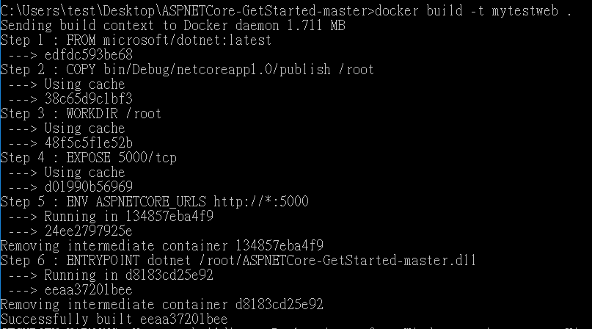
Run .NET Core and ASP.NET Core
On Windows with Docker
建置 Docker Image
docker build -t mytestweb .

Slide 29
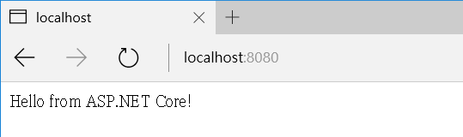

Run .NET Core and ASP.NET Core
On Windows with Docker
使用 Image 建立 Container
docker run -d -p 8080:5000 mytestweb
-d flag tells Docker to run the container in detached mode (in the background)
-p flag will map port 8080 on the host machine to port 5000 inside the container

Slide 30

Dev .NET Core and ASP.NET Core with Docker
On Visual Studio
Developing and debugging your application in a Docker container can be a ceremony of tasks to get setup with various tools. Visual Studio Tools for Docker helps you get past the hurdles and find the bugs using F5 to debug your application directly in a locally hosted Docker Container.
https://docs.microsoft.com/en-us/dotnet/articles/core/docker/visual-studio-tools-for-docker
https://blogs.msdn.microsoft.com/msdntaiwan/2016/06/07/docker-and-asp-net-core/
https://blogs.msdn.microsoft.com/msdntaiwan/2016/06/07/docker-and-asp-net-core/
Prerequisites
Microsoft Visual Studio 2015 Update 3
https://www.visualstudio.com/downloads/download-visual-studio-vs
.NET Core 1.0.1 - VS 2015 Tooling Preview 2
https://go.microsoft.com/fwlink/?LinkID=827546
Docker For Windows to run your Docker containers locally
https://www.docker.com/products/docker#/windows
Download and install the Visual Studio Tools for Docker
https://aka.ms/DockerToolsForVS

Slide 31

Run .NET Core and ASP.NET Core
On Linux (CentOS)
Install .NET Core SDK
sudo yum install libunwind libicu
curl -sSL -o dotnet.tar.gz https://go.microsoft.com/fwlink/?LinkID=827529
sudo mkdir -p /opt/dotnet && sudo tar zxf dotnet.tar.gz -C /opt/dotnet
sudo ln -s /opt/dotnet/dotnet /usr/local/bin

Slide 32


Run .NET Core and ASP.NET Core
On Linux (CentOS)
Use .NET CLI (.NET Core cross-platform command-line interface)
Initialize a sample Hello World application
Run the app

Slide 33
Run .NET Core and ASP.NET Core
ASP.NET Core On Linux (CentOS)
Use .NET CLI
Create a new .NET Core project
Update the project.json file to add the Kestrel HTTP server package as a dependency

Slide 34

Run .NET Core and ASP.NET Core
ASP.NET Core On Linux (CentOS)
Use .NET CLI
Restore the packages
Add a Startup.cs file that defines the request handling logic

Slide 35
Run .NET Core and ASP.NET Core
ASP.NET Core On Linux (CentOS)
Use .NET CLI
Update the code in Program.cs to setup and start the Web host
Run the app

Slide 36


Run .NET Core and ASP.NET Core
ASP.NET Core On Linux (CentOS)
Use .NET CLI
Run the app

Slide 37

Run .NET Core and ASP.NET Core
On Linux (CentOS) with Docker
Install Docker for Linux (CentOS)
https://docs.docker.com/engine/installation/linux/centos/
Prerequisites
Docker requires a 64-bit OS
version 3.10 or higher of the Linux kernel

Slide 38

Run .NET Core and ASP.NET Core
On Linux (CentOS) with Docker
取得官方的 .NET Core Image
docker pull microsoft/dotnet:latest

Slide 39


Run .NET Core and ASP.NET Core
On Linux (CentOS) with Docker
將 ASP.NET Core 程式打包
dotnet publish
執行打包後的程式，確定運作正常
dotnet run bin\Debug\netcoreapp1.0\publish\ASPNETCore-GetStarted-master.dll

Slide 40

Run .NET Core and ASP.NET Core
On Linux (CentOS) with Docker
在專案目錄中建立 Dockerfile
FROM microsoft/dotnet:latest
COPY bin/Debug/netcoreapp1.0/publish /root
WORKDIR /root
EXPOSE 5000/tcp
ENV ASPNETCORE_URLS http://*:5000
ENTRYPOINT dotnet /root/ASPNETCore-GetStarted-master.dll
FROM tells Docker that you want to base your image on the existing image called
COPY and WORKDIR copy the current directory’s contents into a new directory inside the container called and set that to the the working directory for the subsequent instructions
EXPOSE tells Docker to expose port 5000 (the default port for ASP.NET) on the container
ENV sets the environment variable ASPNETCORE_URLS in the container. This will ensure that ASP.NET Core binds to the correct port and address
ENTRYPOINT specifies the command to execute when the container starts up. In this case, it’s dotnet run

Slide 41

Run .NET Core and ASP.NET Core
On Linux (CentOS) with Docker
建置 Docker Image
docker build -t mytestweb .

Slide 42

Run .NET Core and ASP.NET Core
On Linux (CentOS) with Docker
使用 Image 建立 Container
docker run -d -p 8080:5000 mytestweb
-d flag tells Docker to run the container in detached mode (in the background)
-p flag will map port 8080 on the host machine to port 5000 inside the container

Slide 43


Run .NET Core and ASP.NET Core
On Linux (Ubuntu)
Install .NET Core SDK
sudo sh -c 'echo "deb [arch=amd64] https://apt-mo.trafficmanager.net/repos/dotnet-release/ trusty main" > /etc/apt/sources.list.d/dotnetdev.list'
sudo apt-key adv --keyserver apt-mo.trafficmanager.net --recv-keys 417A0893
sudo apt-get update
sudo apt-get install dotnet-dev-1.0.0-preview2-003131

Slide 44


Run .NET Core and ASP.NET Core
On Linux (Ubuntu)
Use .NET CLI (.NET Core cross-platform command-line interface)
Initialize a sample Hello World application
Run the app

Slide 45
Run .NET Core and ASP.NET Core
ASP.NET Core On Linux (Ubuntu)
Use .NET CLI
Create a new .NET Core project
Update the project.json file to add the Kestrel HTTP server package as a dependency

Slide 46

Run .NET Core and ASP.NET Core
ASP.NET Core On Linux (Ubuntu)
Use .NET CLI
Restore the packages
Add a Startup.cs file that defines the request handling logic

Slide 47
Run .NET Core and ASP.NET Core
ASP.NET Core On Linux (Ubuntu)
Use .NET CLI
Update the code in Program.cs to setup and start the Web host
Run the app

Slide 48


Run .NET Core and ASP.NET Core
ASP.NET Core On Linux (Ubuntu)
Use .NET CLI
Run the app

Slide 49

Run .NET Core and ASP.NET Core
On Linux (Ubuntu) with Docker
Install Docker for Linux (Ubuntu)
https://philipzheng.gitbooks.io/docker_practice/content/install/ubuntu.html
https://docs.docker.com/engine/installation/linux/ubuntulinux/
Prerequisites
Docker requires a 64-bit OS
version 3.10 or higher of the Linux kernel

Slide 50

Run .NET Core and ASP.NET Core
On Linux (Ubuntu) with Docker
取得官方的 .NET Core Image
docker pull microsoft/dotnet:latest

Slide 51


Run .NET Core and ASP.NET Core
On Linux (Ubuntu) with Docker
將 ASP.NET Core 程式打包
dotnet publish
執行打包後的程式，確定運作正常
dotnet run bin\Debug\netcoreapp1.0\publish\ASPNETCore-GetStarted-master.dll

Slide 52

Run .NET Core and ASP.NET Core
On Linux (Ubuntu) with Docker
在專案目錄中建立 Dockerfile
FROM microsoft/dotnet:latest
COPY bin/Debug/netcoreapp1.0/publish /root
WORKDIR /root
EXPOSE 5000/tcp
ENV ASPNETCORE_URLS http://*:5000
ENTRYPOINT dotnet /root/ASPNETCore-GetStarted-master.dll
FROM tells Docker that you want to base your image on the existing image called
COPY and WORKDIR copy the current directory’s contents into a new directory inside the container called and set that to the the working directory for the subsequent instructions
EXPOSE tells Docker to expose port 5000 (the default port for ASP.NET) on the container
ENV sets the environment variable ASPNETCORE_URLS in the container. This will ensure that ASP.NET Core binds to the correct port and address
ENTRYPOINT specifies the command to execute when the container starts up. In this case, it’s dotnet run

Slide 53

Run .NET Core and ASP.NET Core
On Linux (Ubuntu) with Docker
建置 Docker Image
docker build -t mytestweb .

Slide 54

Run .NET Core and ASP.NET Core
On Linux (Ubuntu) with Docker
使用 Image 建立 Container
docker run -d -p 8080:5000 mytestweb
-d flag tells Docker to run the container in detached mode (in the background)
-p flag will map port 8080 on the host machine to port 5000 inside the container

Slide 55
About refactor current job program
沒有將與 GUI 高度相關的 API 移植到 .NET Core 內
原 JOB 程式中的業務邏輯代碼應都可沿用
第三方元件不一定有 .NET Core 版本，需要確認是否有更新或尋找其他適用的元件或是自行開發
資料存取元件
Newegg.Oversea
StackExchange.Redis
檔案處理元件
Aspose
Dcg
StringTemplate
ximpleware
其他參考元件
log4net
PostSharp

